Slide 1


A Study on Automobile Engine test results of various configurations
By : Ravi Krishna Kyram

Slide 2
Presentation Outline :
1. Business Objective
2. Data Source
3. Approach
4. Methodology
5. Visualizations
6. Evaluation / Results
7. Summary

Slide 3



Business Objective:
Determine factors used for Predicting test results of various configurations
Predict the likeliness of Test
Results of various configurations
Reduce bench tests of an automotive engine is an expensive, noisy and time consuming process

Slide 4

Data Source:
Source : Sample Data : Train, Test, Train_AdditionalData,Test_AdditionalData
Statistics :
Train Rows : 3156
Features : 22
Primary Feature : y (Pass/Fail)

Slide 5
Data Source:
Source : Sample Data : Train, Test, Train_AdditionalData,Test_AdditionalData
Statistics :
Train Rows : 3156
Features : 22
Primary Feature : y (Pass/Fail)

Slide 6
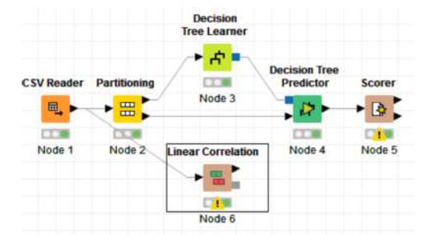

Approach:
Problem Statement:
22 Features extracted from Raw Data
Build predictive model using Multiple Techniques
Optimal model identifies using testing & evaluation
S.No | Attributes
1 | Number of Cylinders
2 | material grade
3 | Lubrication
4 | Valve Type
5 | Bearing Vendor
6 | Fuel Type
7 | Compression ratio
8 | cam arrangement
9 | Cylinder arrangement
10 | Turbocharger
11 | Variable Valve Timing (VVT)
12 | Cylinder deactivation
13 | Direct injection
14 | main bearing type
15 | displacement
16 | piston type
17 | Max. Torque
18 | Peak Power
19 | Crankshaft Design
20 | Liner Design

Slide 7
Methodology:
Problem Statement:
Machine Learning
Algorithm
Naïve Bayes
Decision Tree
Random Forest
SVM
Gradient Boost
Tools of Disposal
R Studio
Jupyter Notebook
(Python)
MS office

Slide 8
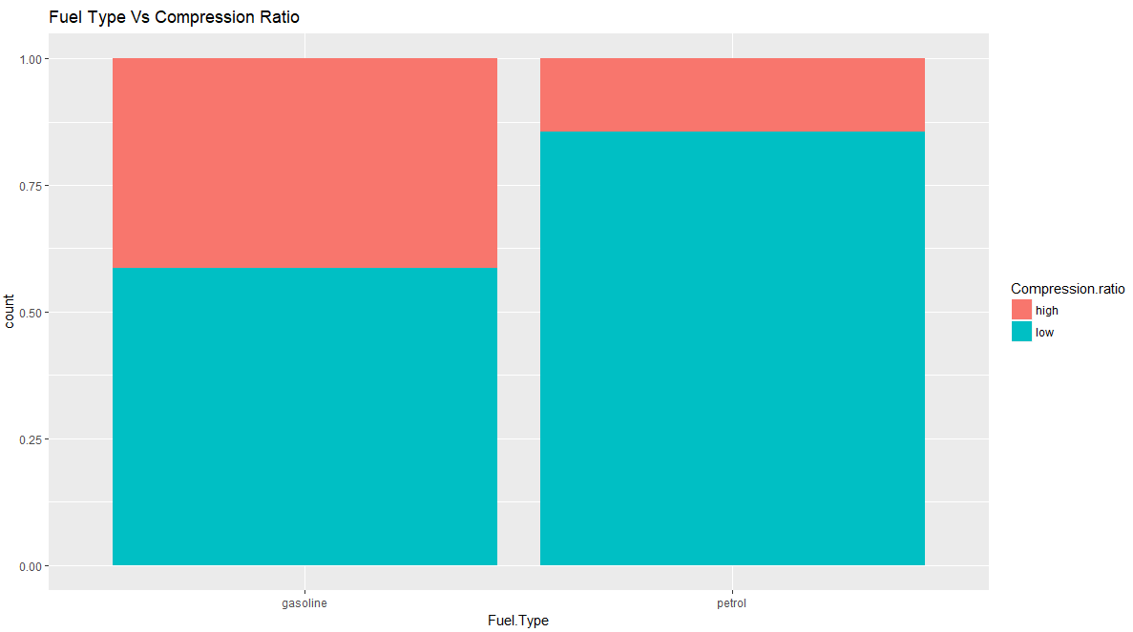
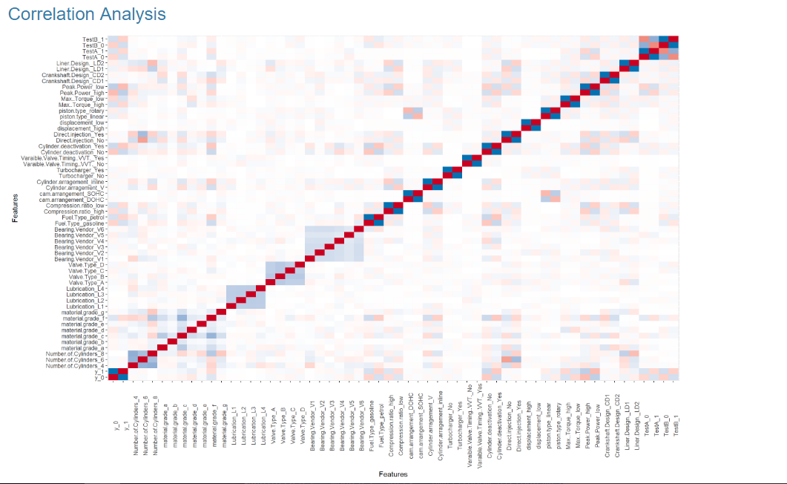
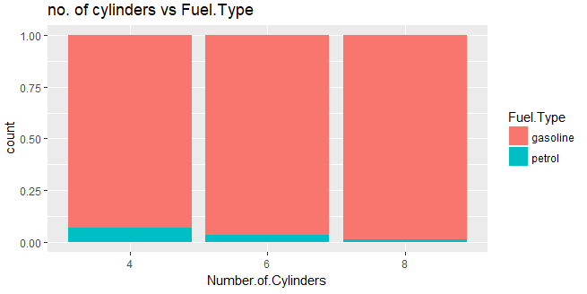
Visualizations:
Problem Statement:
It has been observed that gasoline engine, compression ratio low for about 60% engines and high for 40% engines where as for petrol engines almost 80% engines have low compression ratio .
As no. of cylinders increases the petrol engines are less.

Slide 9
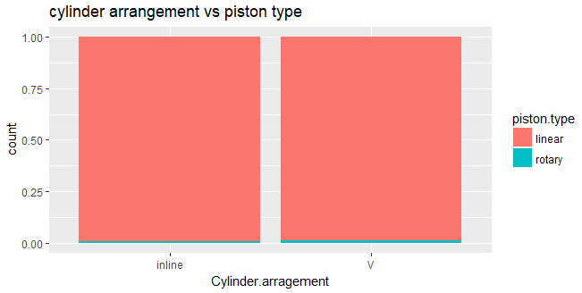
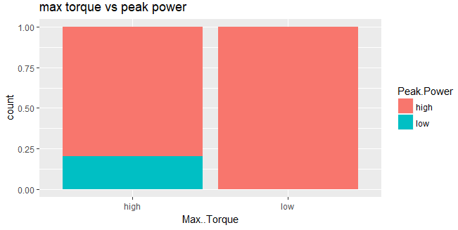
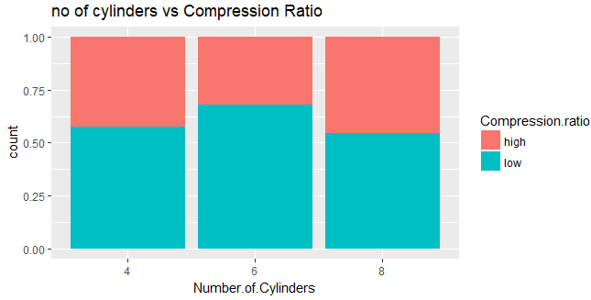
Visualizations:
Problem Statement:
Rotary pistons are used more v cylinder compared to inline cylinders.
If peak power is used in engines then torque should be low
In 6 cylinders low compression ratio is used more compared to other
type of cylinders

Slide 10
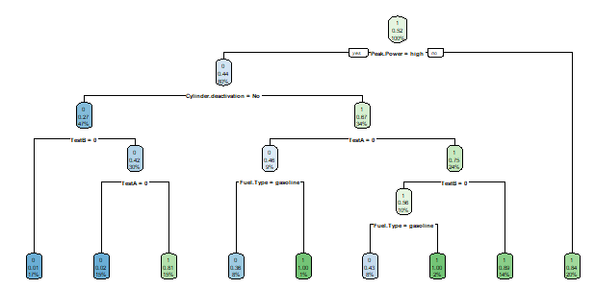
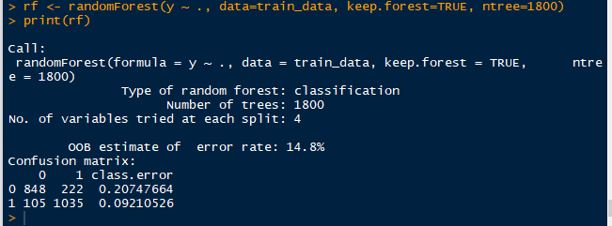
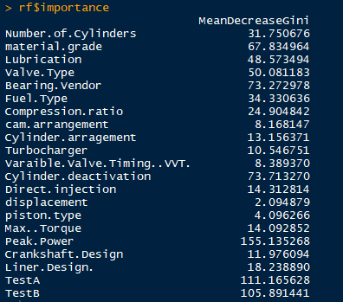
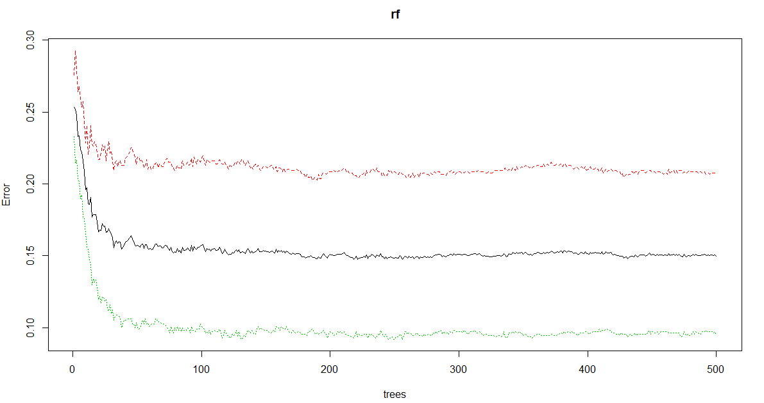
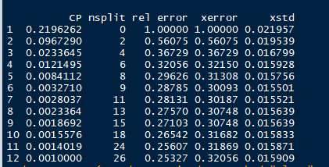


Decision Tree:
Decision Tree:
Random Forest:
Tuning to get ntree
Train
Accuracy 86 %
Test
Cp = 0.032710
Accuracy 87 %

Slide 11
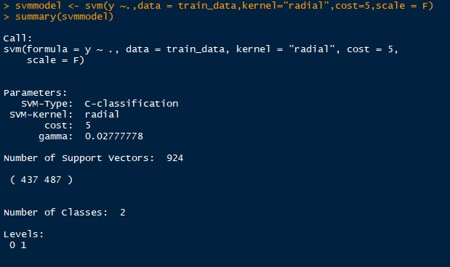
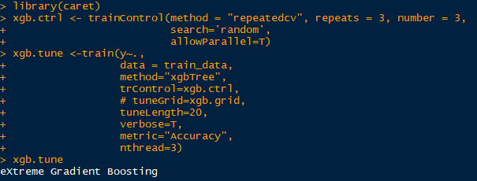
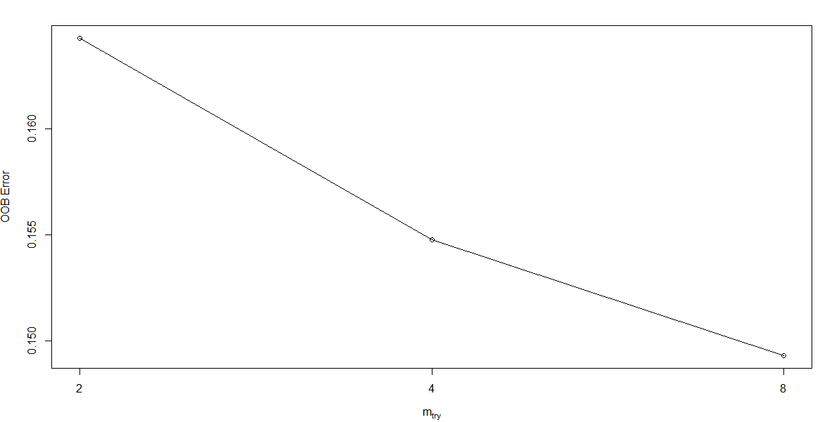

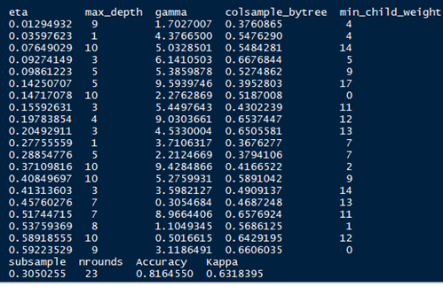
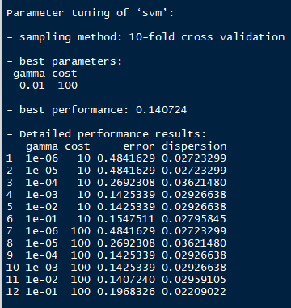
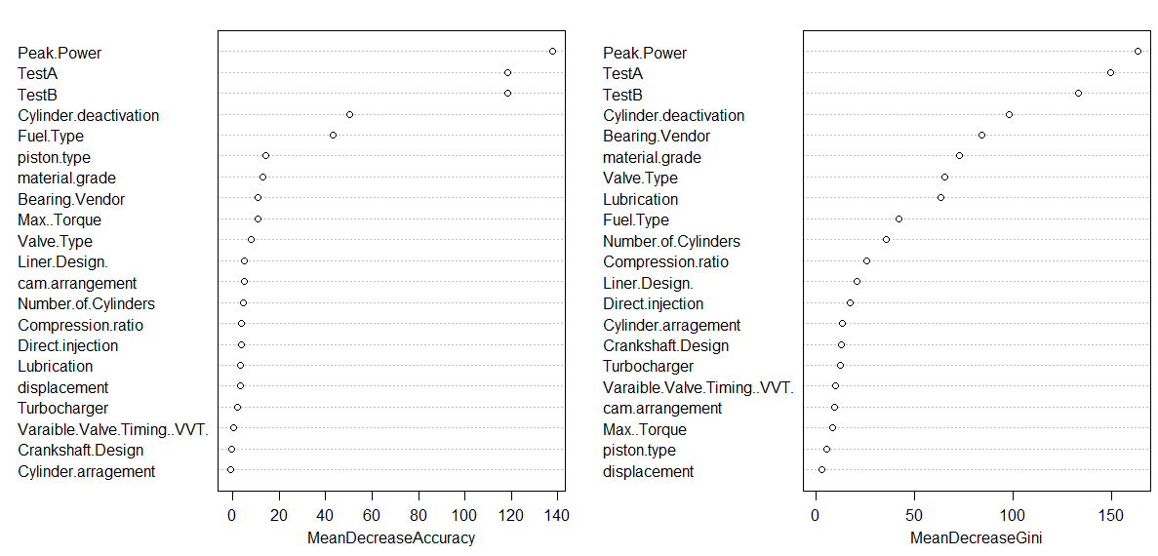

Random Forest:
SVM:
XG Boost:
Tuning to get mget
Train
Accuracy 94 %
To know the importance of variables
Test
Accuracy 87 %
Gamma =0.01,cost=10
Train Accuracy 89 % Test Accuracy 86%
Train Accuracy 87 % Test Accuracy 89%

Slide 12
Evaluations/Results:
Problem Statement:
13%
13 % of automotive engine test results Failing across
the given configurations

Slide 13
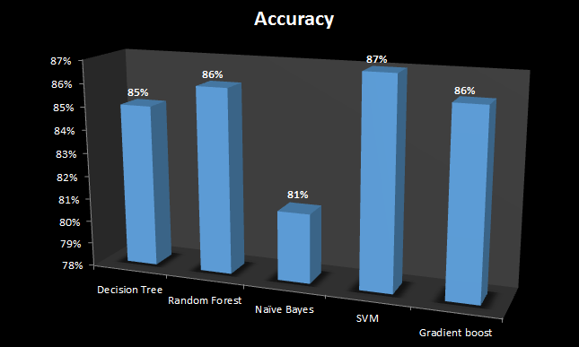
Accuracy Percentage:
Problem Statement:
Machine Learning Algorithm | Accuracy Percentage Score | Error Percentage
Decision tree | 85 | 15
Random forest | 86 | 14
Naïve Bayes | 81 | 19
SVM | 87 | 13
Gradient boost | 85 | 15

Slide 14
Conclusion:
SVM Model is giving the better accuracy (87%) to identify the test failures
of Automobile Engines of various configurations .

